Slide 1
Status of the European Spallation Source
Timo Korhonen
Chief Engineer, Integrated Control System Division
www.europeanspallationsource.se
October 21, 2014

Slide 2
The European Spallation Source
An accelerator-based neutron source to be built in Lund, southern Sweden
Material and life sciences research
A collaboration of 17 European nations
Construction budget about 1860 million Euro
Targeted to be the world’s most powerful neutron source
5 MW beam power, 2.5 GeV proton energy, 14 Hz repetition rate, 2.86 ms pulse@50 mA beam current
Superconducting linac, rotating tungsten target
22 neutron beam lines in construction budget

Slide 3
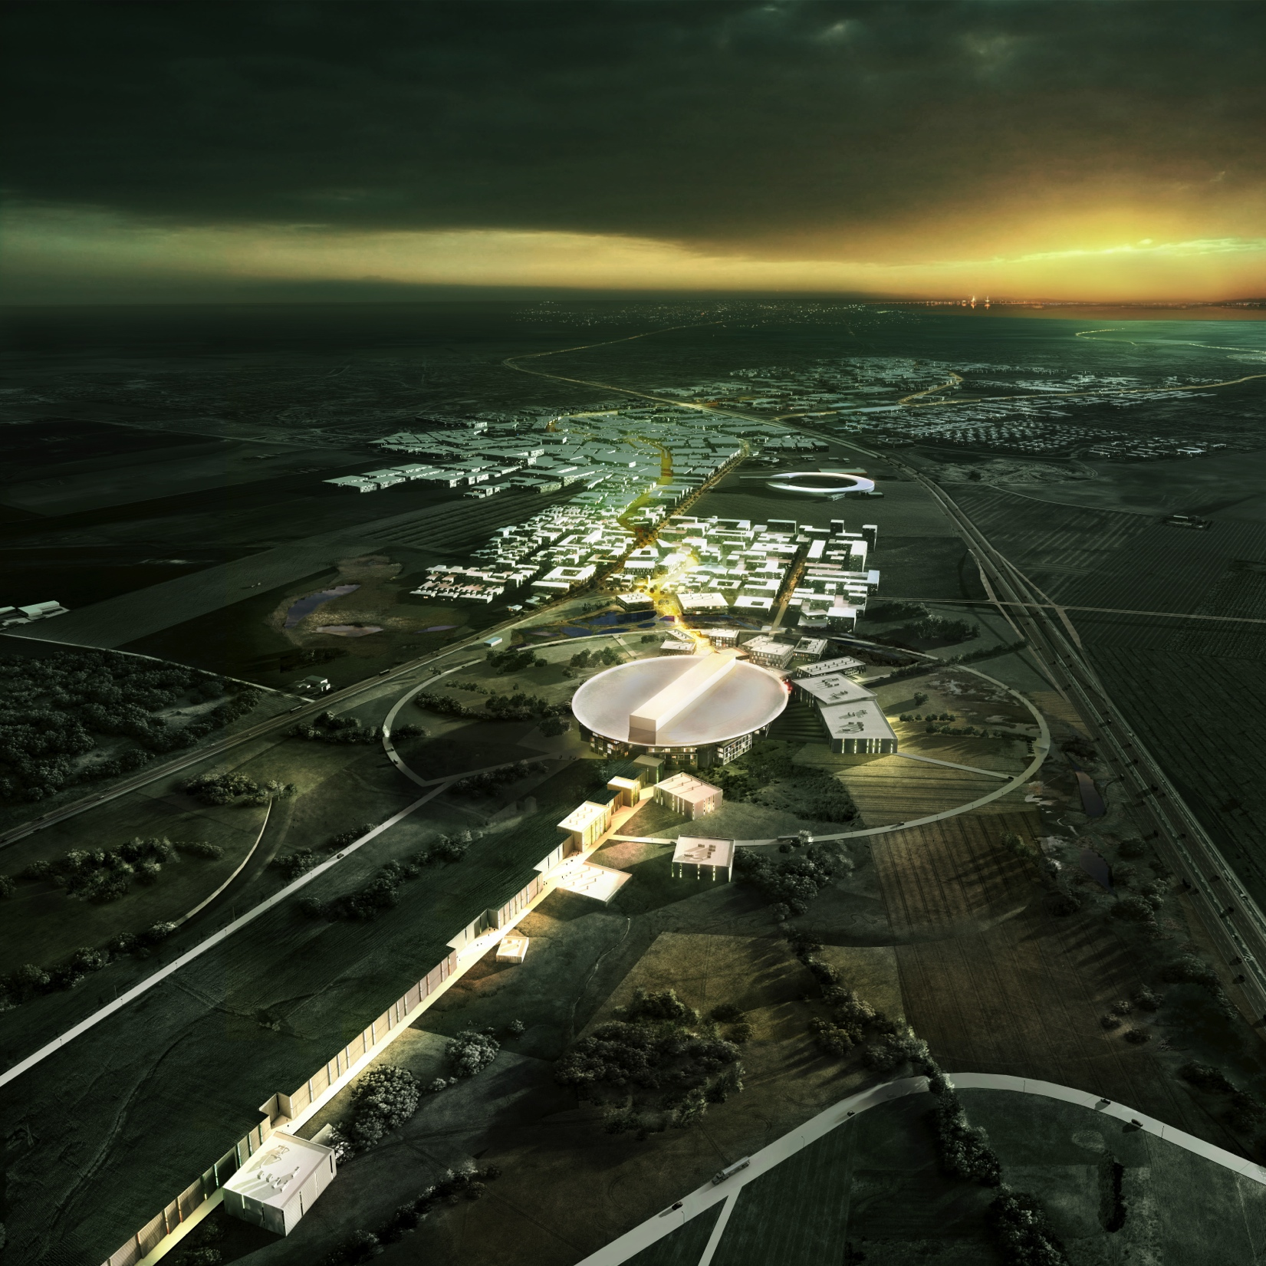
The European Spallation Source
First protons planned by 2019
Project completion by 2025
Full beam power, 22 neutron beam lines
Accelerator in Lund,Sweden and data processing center in Copenhagen, Denmark

Slide 4
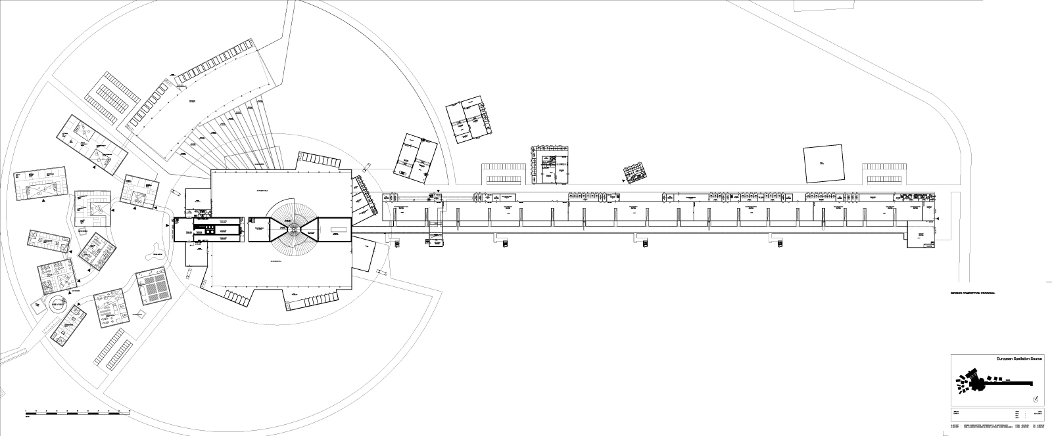
Machine layout
(200 m)

Slide 5
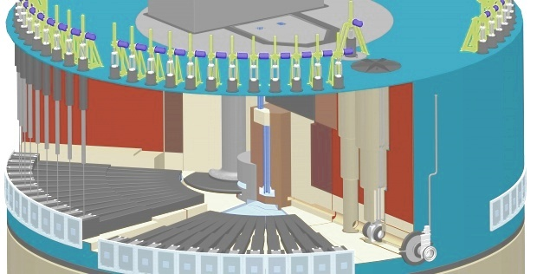
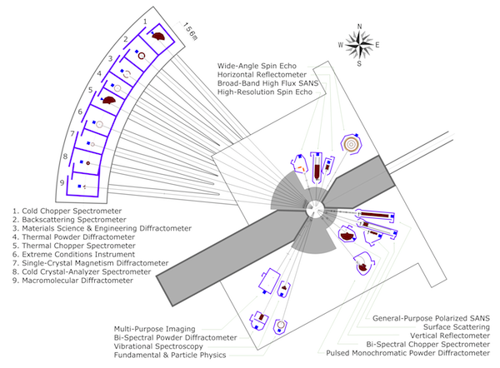
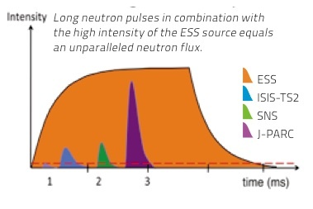
Target and the neutron beam lines
Rotating wheel target – beam has to hit in the middle of the sector.

Slide 6
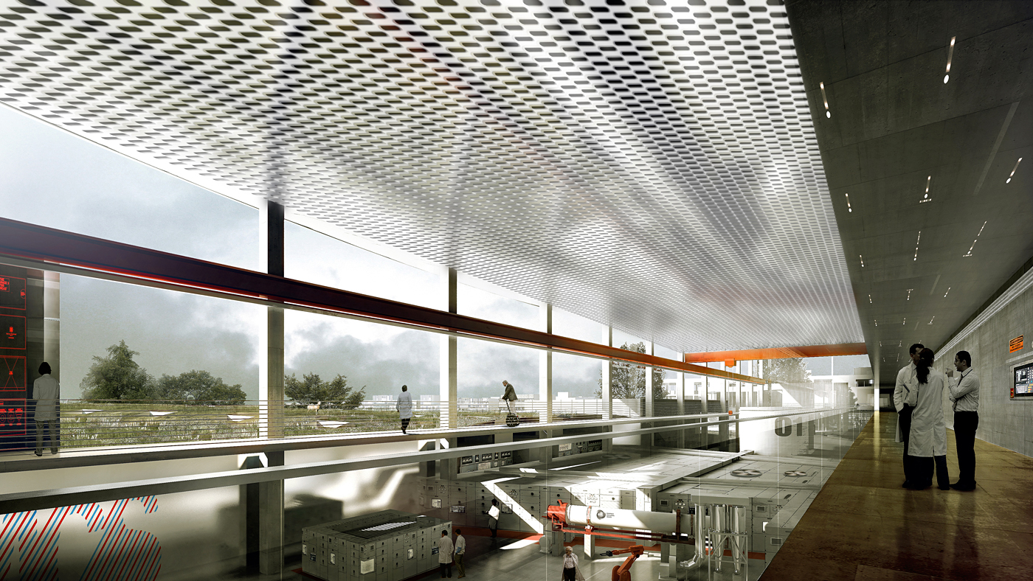
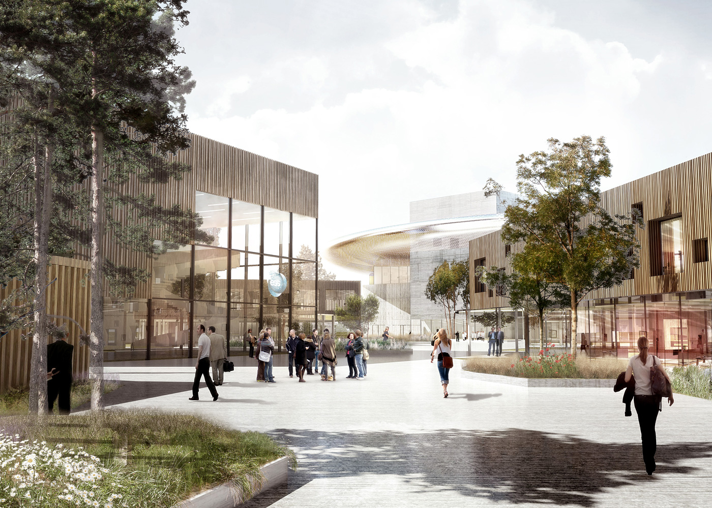
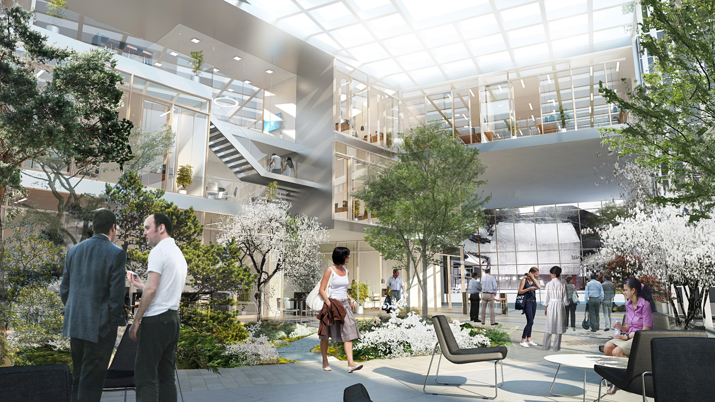
Office and experiment areas – nice…

Slide 7
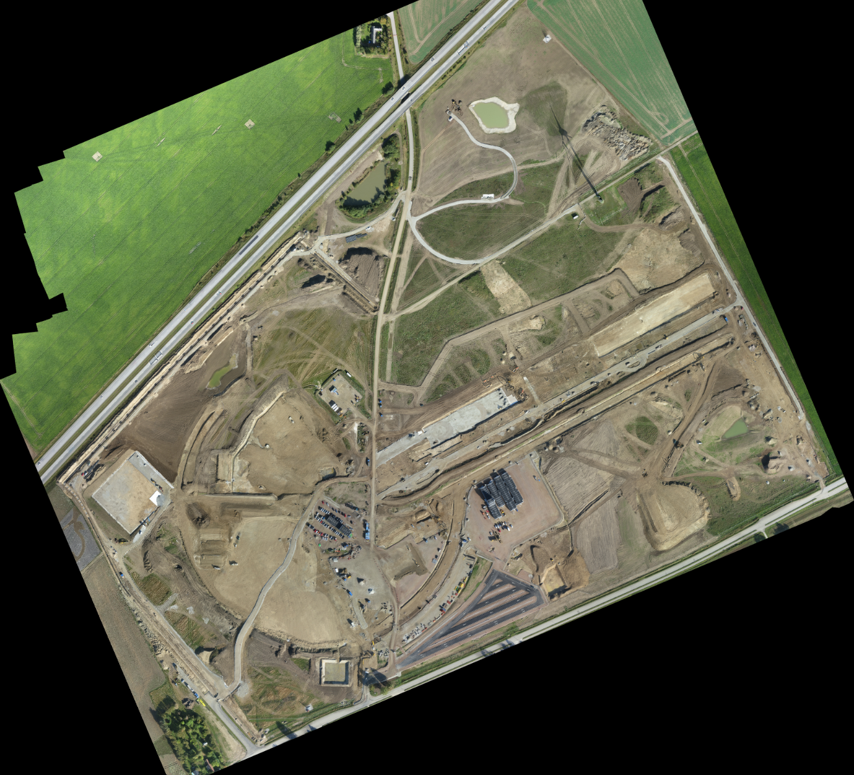
ESS construction has started!
ESS is funded
and
Construction is underway!
This aerial photo has been taken about two weeks ago.

Slide 8
ESS Control System
ESS Integrated Control System Division (ICS) is in charge of building the control system(s) for the accelerator, the neutron target, and providing controls for the beamline components (in cooperation with the colleagues from science directorate)
Project scope includes also
Conventional facilities control integration
protection systems (Machine, Personnel)
Global timing system for site-wide synchronization
Some parts of the controls will be provided by ESS partner laboratories as in-kind contributions
e.g., proton source and LEBT controls by Saclay (France)

Slide 9
Some technology decisions
Using EPICS for controls in the whole facility
From accelerator to neutron beamlines
Plan to benefit from EPICS version 4 facilities
pvAccess as the binding communicating layer
Services (e.g. physics model as a service) for the accelerator
Participating in the DISCS (Distributed Services for Controls) collaboration
Databases and applications for facility and device configuration data
Middle-layer services (see http://openepics.sourceforge.net/)
CS-Studio as the generic user interface tool
Control room, subsystem developers, etc.
Committed to work together with the EPICS community
Combining our resources we can make more and better things

Slide 10
Technology decisions cont.
Using MRF event system for global timing
Synchronization in the whole facility
Timing supports beam synchronous applications (in discussion with PSI about co-development)
Looking at future developments together with some new projects (ELI-Beams, SwissFEL, others)
Machine protection is of prime importance
Ability to switch off beam mid-pulse (10 us time range)
FPGA-based fast interlock
Slow devices connected to PLC-based system
Has to be synchronized with beam operation
Ramping up with beam intensity, pulse length and repetition rate

Slide 11
Controls hardware decisions
Defining hardware standards – for the whole spectrum
Standardize on one PLC brand – as far as we can
To reduce complexity
Digital platform form factor
One form factor should cover the segment of fast signal processing
Mainly beam diagnostics and LLRF
Going towards MTCA.4 – carefully, though
Still a new standard with compatibility, etc., issues
Setting up collaborations for a full framework
FMC standards, development framework for the whole cycle (HW&FW&SW)
Plan to use EtherCAT for middle range between PLCs and MTCA
pulse-synchronized operations, distributed, kHz range acquisition

Slide 12
Controls platforms
Evaluating motion controller platforms
Current designs based on DeltaTau GeoBrick
Working together with colleagues from science directorate
Controls network design starting
a network and servers expert hired recently
Server hall (Lund site) design ongoing
Starting to look at virtualization solutions
“soft” IOC deployment, development servers
Collaborative tools in heavy use
Atlassian toolkit: JIRA (bugtracker), Confluence (Wiki, web tool) and BitBucket (repository/Git management)

Slide 13
Common services
Configuration databases and related tools
(Controls) configuration, cabling, naming service, access control (RBAC) etc.
IOC development workflow and tools
Still searching for optimal development and deployment flow
How to deploy 600+ IOCs in a short time?
How to manage these after deployment?
How to support our off-site partners>
“IOC Factory” – you will hear about that in the future
Use tools from the community whenever possible
CS-Studio, Archiver, Save&Restore, alarm handler
Contribute to development when appropriate
Use resources to develop things that do not exist
Our local infrastructure, for example…

Slide 14
Summary
ESS construction has started
New accelerator, new institute, new…everything
Roll up the sleeves and start building systems
Control system effort is ramping up
Moving from prototyping to design decisions
Hiring people (watch our web pages!)
Working in collaborations and with in-kind contributors in member states (still looking for partners)
Lots of things to build
Many challenges, many opportunities

